Slide 1
Object-Oriented Design
Programming – Code Design & Data Structures
Last modified 2/11/15 by Jeff Cotter

Slide 2
Contents
Procedural Programming
Limitations
Object-Oriented Programming
The Tenets of OOP
Abstraction
Encapsulation
Inheritance
Polymorphism

Slide 3
Procedural Programming
Top-down design
Discrete functions performing small tasks
Data transfer via function parameters, return values, global variables
Procedures (functions) and Data
Procedures and data are separate (or loosely coupled)
Similar functions are collected together

Slide 4
Limitations of Procedural Programming
Functions are usually global
Functions are task specific, not data specific
There tend to be many similar functions which only differ by the type of data they are manipulating
This makes the code difficult to maintain
Quickly increases in complexity
Adding new functionality becomes progressively more difficult as the project complexity increases
The code can become large and difficult to understand

Slide 5
Object Oriented Programming
What if functions were tied to data and not the other way around?
In object oriented programming code is structured around objects, their relationships, and their interfaces

Slide 6
Example
Consider objects needed for Space Invaders
Invaders
Players
Bullets
What data and functionality is required by each object?
Data: Position, lives, speed, etc
Functions: move, shoot, die, etc

Slide 7
Objects (Classes)
Bind together data and functions
Objects have a declaration and definition, just like functions
An object is a programmer-defined complex data type
C++ calls this a class or structure

Slide 8
Objects, not functions
OOP divides a program into Objects, not functions
Objects are:
Any entity involving data and operations on that data
Any game component
Splash screens, menu, level manager, etc.
Doesn’t need to be a tangible thing
Different behaviours for an NPC could each be class

Slide 9
Four main tenets of OO
There are four buzzwords which are used to sum up what OO is about
Abstraction
Encapsulation
Inheritance
Polymorphism

Slide 10
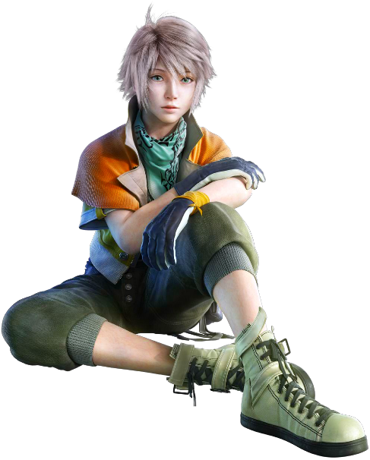
Abstraction
Abstraction is the process by which general rules and concepts are derived from specific examples
For example imagine we want to write code for a character in an RPG game:
Our design might include concept art with amazing costume, hair etc
But if the only thing which effects the behaviour of the NPC in the game is a set of stats and it’s position in the world, that’s all we have in our object - it is an abstract representation

Slide 11
Encapsulation and reusability
Each object has its own set of variables and functions
These are all related to the purpose of the object
Objects are defined to be reusable
For example, a programmer might build a user menu from four object types: Button, image, sound, and text box
These four types can be used repeatedly to create a larger, more complex menu system

Slide 12
Encapsulation and interfaces
An object might contain a great deal of functionality
But only a small amount of it is of interest to other objects
Encapsulation allows us to hide the stuff which is not of interest to the object from the outside world
We can limit how much access the outside world has to our object
This provides greater security and control

Slide 13
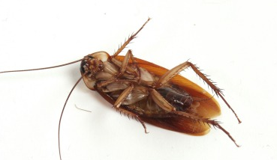
Interface Example
We want to write code for an NPC in our game
It has a variable which represents health of the NPC
When the NPC gets attacked, that health variable is reduced. If it reaches 0 the NPC dies
In OO we want to make the variable “private”, so that it can only be accessed by functions contained in the object
We produce a “public” function to decrement the health. The same function can check that when health reaches zero the NPC dies
Encapsulation and interfaces make it easier to write bug resistant code
Notes:
The advantage of using the decrement health function is that health in the NPC can now never go below zero without the NPC dying. Health can also never go up again. If we want to know what the health of the NPC is from outside the object then we can produce a public function which allows outside objects to read the variable. Interface provides us with safe ways to manipulate our objects

Slide 14
Inheritance
Objects can inherit from other objects
For example in our game world we might have the following hierarchy of objects:
Thing
Static Mesh
MOB
NPC
Player
Collision
No Collision

Slide 15
Inheritance
Things – have a position in the world
MOB – have a controller to move them around
Player – takes input
NPC – has AI
Static meshes can have collision or not
Each of the objects inherits all the attributes of it’s parent
We re-use functionality and hence reduce the amount of code we have to write
Quicker and easier to maintain

Slide 16
Objects can be hierarchical
Objects can contain other objects
Simpler objects combine into more complex ones
Similar to how structures can be put inside others

Slide 17
Menu Example
Main Menu
3x Buttons
1x Text Box
1x Background Image
Button Object
Size
Text
Position
Draw()
Text Box Object
Size
Text
Position
Draw()
Background Image Object
Image
Size
Draw ()

Slide 18
Polymorphism
This is probably the trickiest OO tenet to understand
But you’ve already come across it before with function overloading
For OO it’s closely related to inheritance
We’ll talk about how in detail in another session

Slide 19
Summary
Object oriented programming offers a number of advantages over the traditional procedural programming approach
C++ calls its objects classes, which are basically structures with a lot more functionality
More on OOP to come!

Slide 20
References
Prata, S, 2011, C++ Primer Plus, 6th Edition, Addison-Wesley Professional

